Slide 1
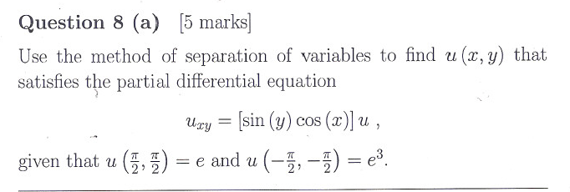
CH 8 pass Exam Qs

Slide 4
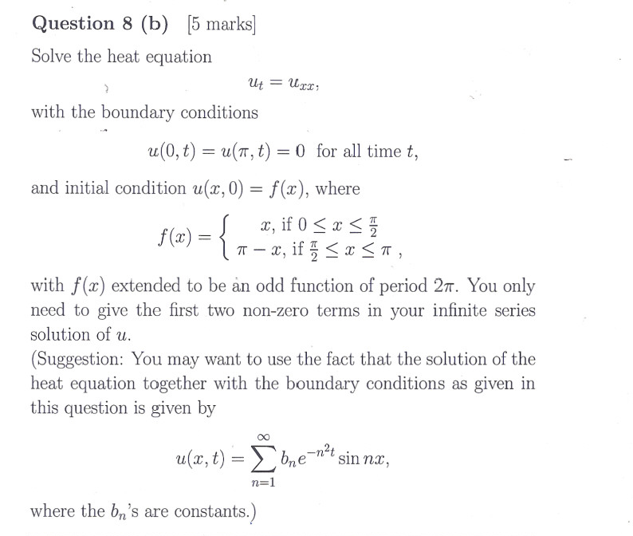

Slide 5
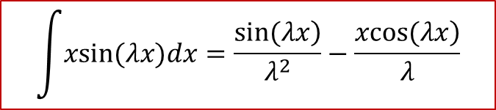
$$\int{xsin(λx)dx=\frac{\left.sin(λx\right)}{λ^{2}}}−\frac{\left.xcos(λx\right)}{λ}$$

Slide 8
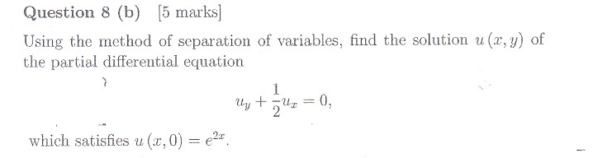

Slide 11
